Slide 1
Reading
Matthew (ਮੱਤੀ) 16:13-16,
& Luke (ਲੂਕਾ) 9:51-53

Slide 2
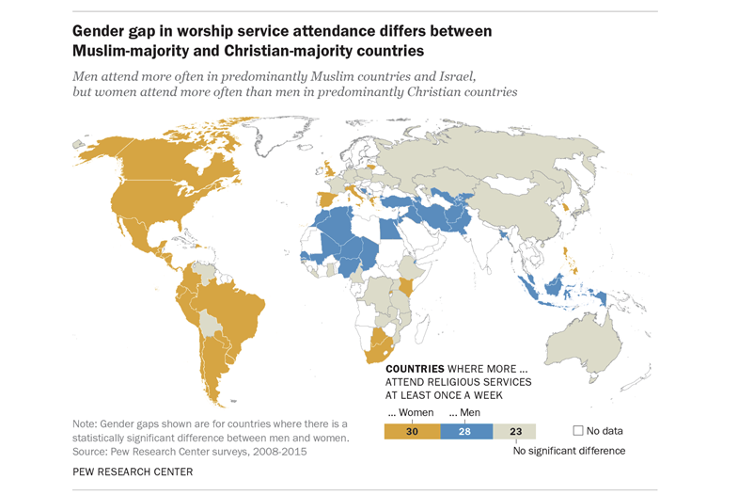

Slide 3
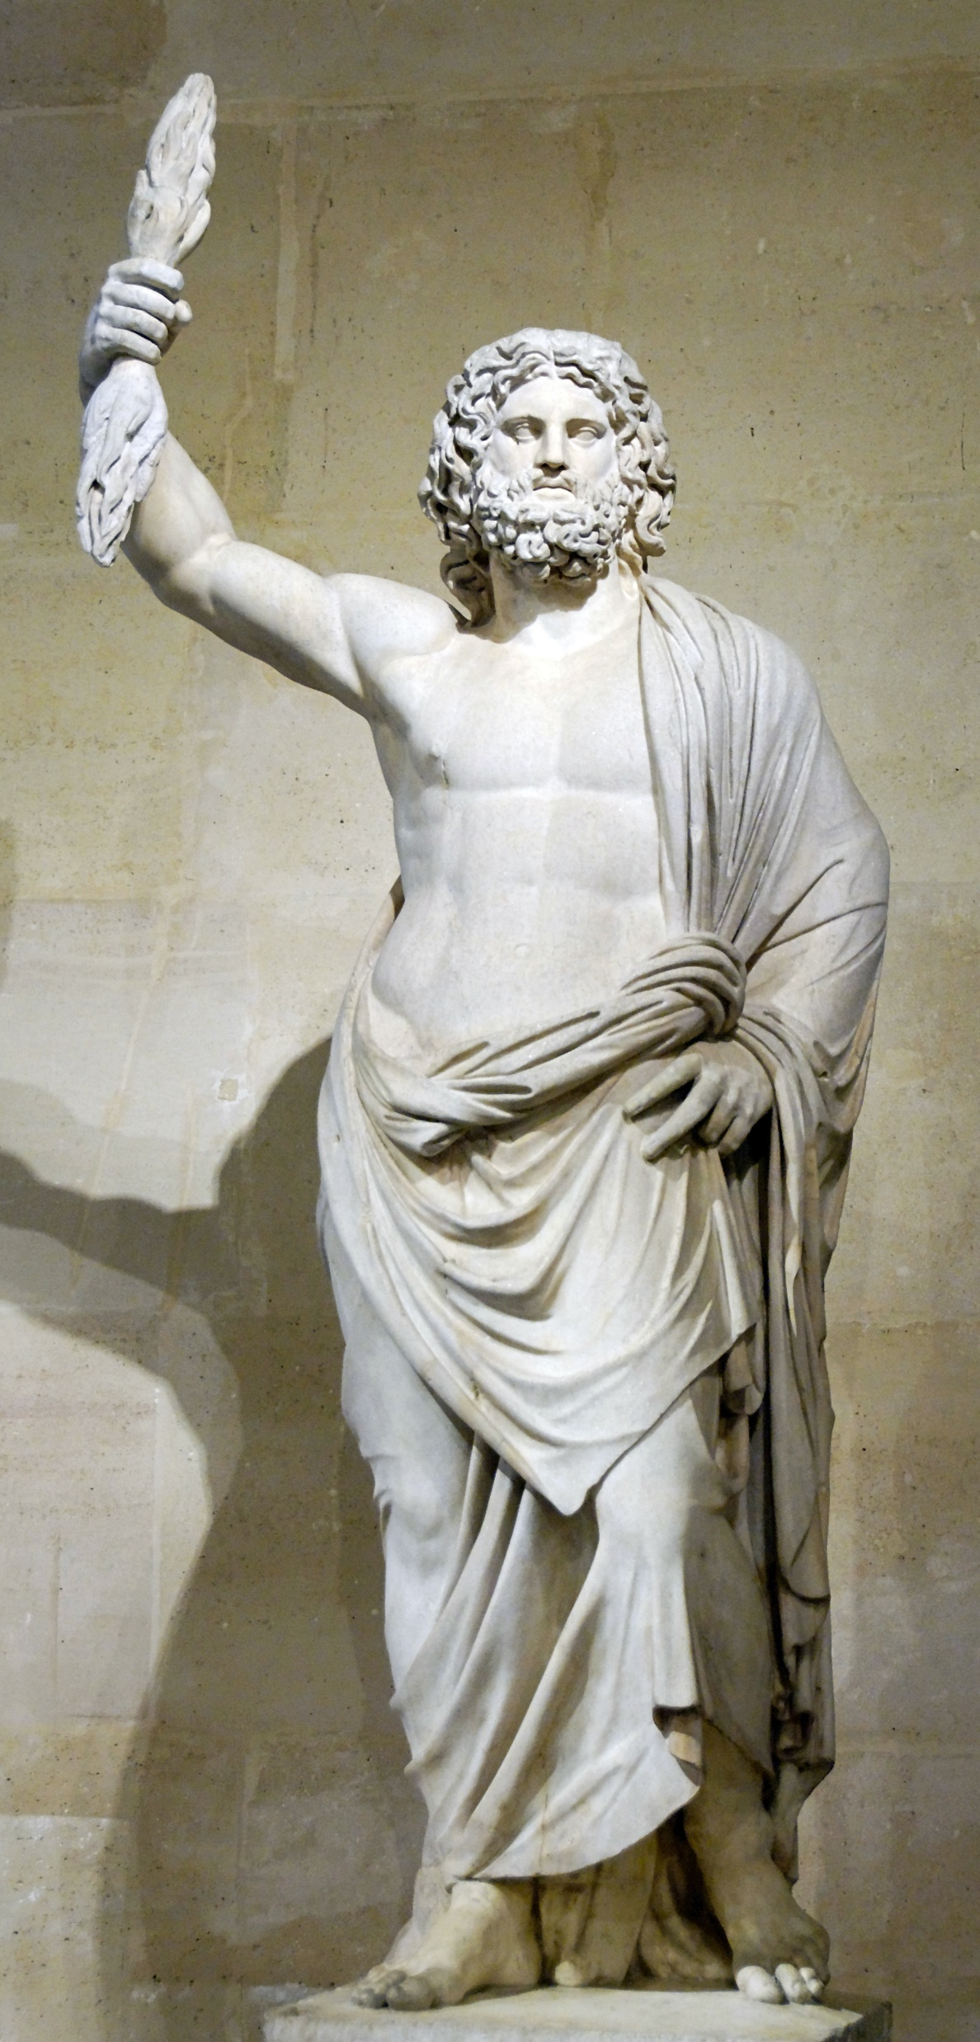
As Christian men we are called to be like Christ (Romans 8:29) and imitate him (1 Cor 11:1)
Mediterranean god - Zeus

Slide 4
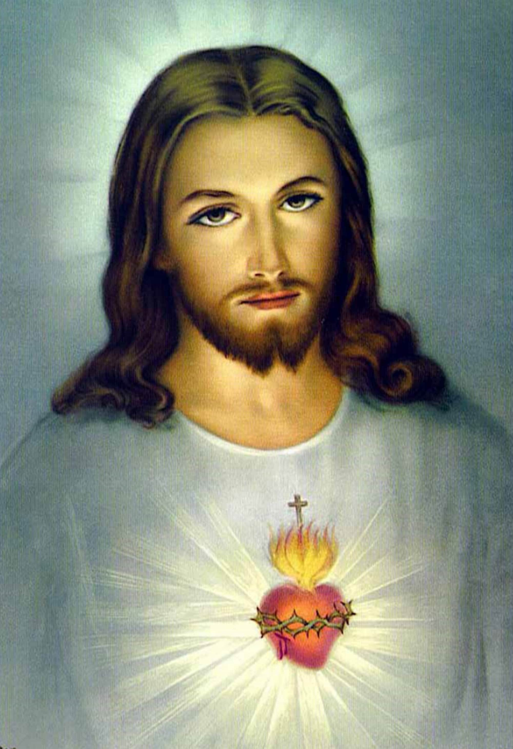
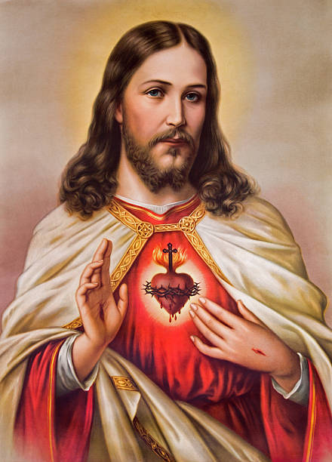

Slide 5
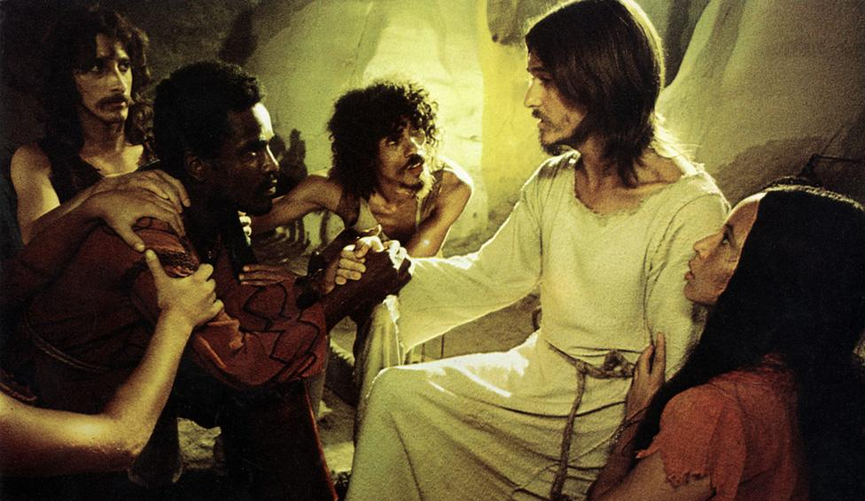
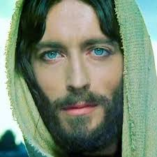

Slide 7
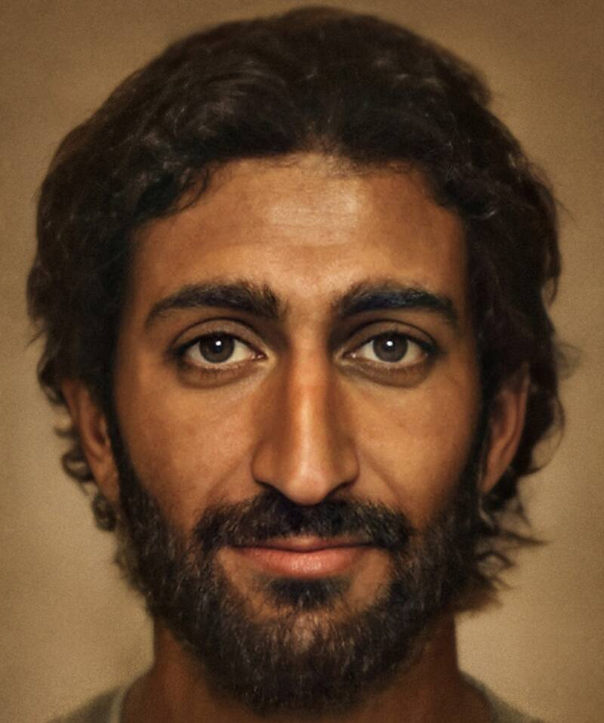

Slide 8
As Christian men we are called to be like Christ (Romans 8:29) and imitate him (1 Cor 11:1)

Slide 9
The feminisation of the church
and the manliness of Jesus
As Christian men we are called to be like Christ (Romans 8:29) and imitate him (1 Cor 11:1)
1 Cor 16:13 – “be brave” can be translated “act like a man”
Matthew 16:13-14 – People thought Jesus was John the Baptist or Elijah
Men are called to be manly men like Christ
(1) Jesus as a manly man was physically strong
Mark 5:30
(2) Jesus as a manly man was courageous
Luke 9:51 & Isaiah 50:7, Hebrews 11:34, Daniel 11:32
(3) Jesus as a manly man was fearless in declaring the truth
Matthew 23:27
(4) Jesus as a manly man demonstrated sacrificial love
Ephesians 5:25, 1 Cor 13:48, Mark 10:32 1 Cor 11:22-33

