Slide 1
Bible Reading
Ephesians (ਅਫ਼ਸੀਆਂ) 6:1-4

Slide 2
“Bringing up your Children”
(Ephesians 6:4b)
Bring your children into a relationship with God
(2) Bring your children up by nurturing them

Slide 7
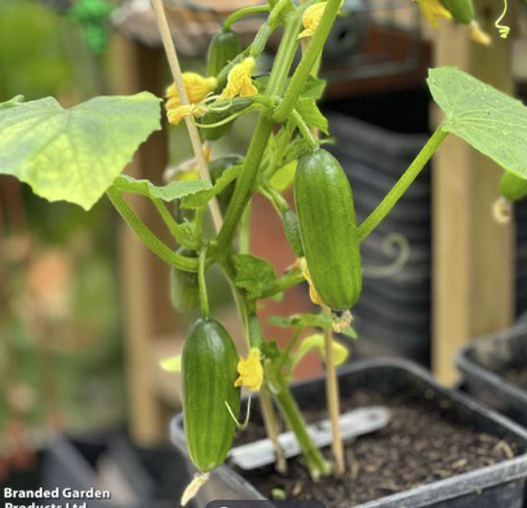

Slide 8
“Bringing up your Children”
(Ephesians 6:4b)
Bring your children into a relationship with God
(2) Bring your children up by nurturing them
Bring your children up by disciplining and instructing them
Training (discipline) Proverbs 13:24, 19:18, Hebrews 12:6
Admonition (instruction)
Advice
Eat at least one meal as a family together, get a big table
Reading something from the Bible and pray together, keep it short
Bring your children to church and meetings geared for them
Use every opportunity to bring God into the conversation
Let them see God in your actions

