Slide 1
Bible Reading
Exodus 3v11-14 & 4v1-9

Slide 2
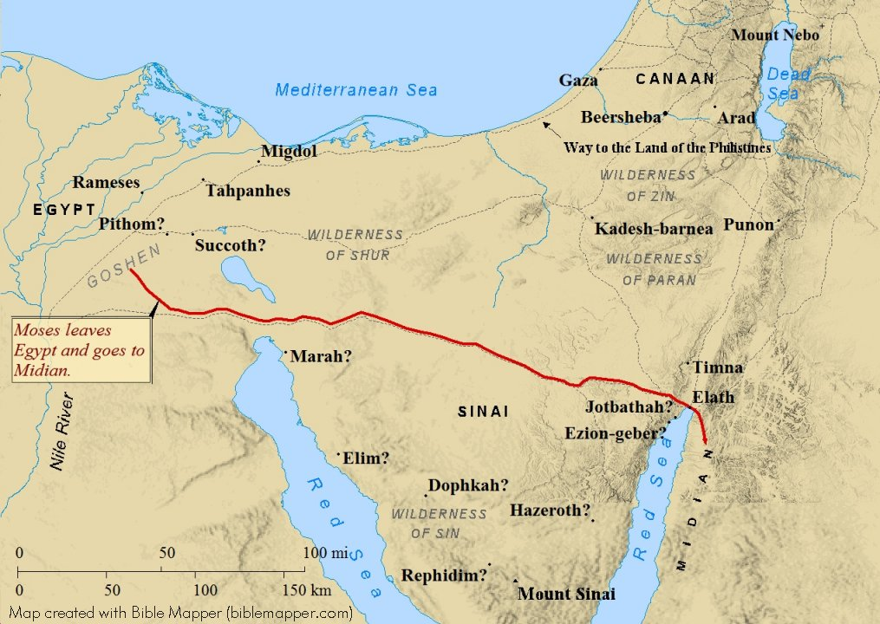
Moses flees from Egypt to Midian

Slide 3
Moses’ excuses and God’s response
(1) Excuse 1 - What shall I say, who has sent me?
Response – “I am who I am” – meaning of YHWH or Yahweh or Jehovah the eternal and unchanging God
(2) Excuse 2 - “What if they do not believe?”
Response 3 signs
(i) Staff becomes a serpent

Slide 5
Moses’ excuses and God’s response
(1) Excuse 1 - What shall I say, who has sent me?
Response – “I am who I am” – meaning of YHWH or Yahweh or Jehovah the eternal and unchanging God
(2) Excuse 2 - “What if they do not believe?”
Response 3 signs
(i) Staff becomes a serpent
(ii) Hand becomes leprous
(iii) Water from Nile becomes blood
(3) Excuse 3 - “I am not eloquent”
Response - I will be with you
(4) Excuse 4 - “Send someone else”
Response – He provides Aaron to speak and give support

