Slide 1
Bible Reading
John 20:19-23

Slide 2
John 20:19-23
¹⁹ Then, the same day at evening, being the first day of the week, when the doors were shut where the disciples were ^{[a]}assembled, for fear of the Jews, Jesus came and stood in the midst, and said to them, “Peace be with you.” ²⁰ When He had said this, He showed them His hands and His side. Then the disciples were glad when they saw the Lord. ²¹ So Jesus said to them again, “Peace to you! As the Father has sent Me, I also send you.” ²² And when He had said this, He breathed on them, and said to them, “Receive the Holy Spirit. ²³ If you forgive the sins of any, they are forgiven them; if you retain the sins of any, they are retained.”

Slide 3
The resurrection of Christ and fear
(John 20:19-23)
The disciples fears
How were the disciples fear dispelled?
Christ’s presence
Christ’s love

Slide 4
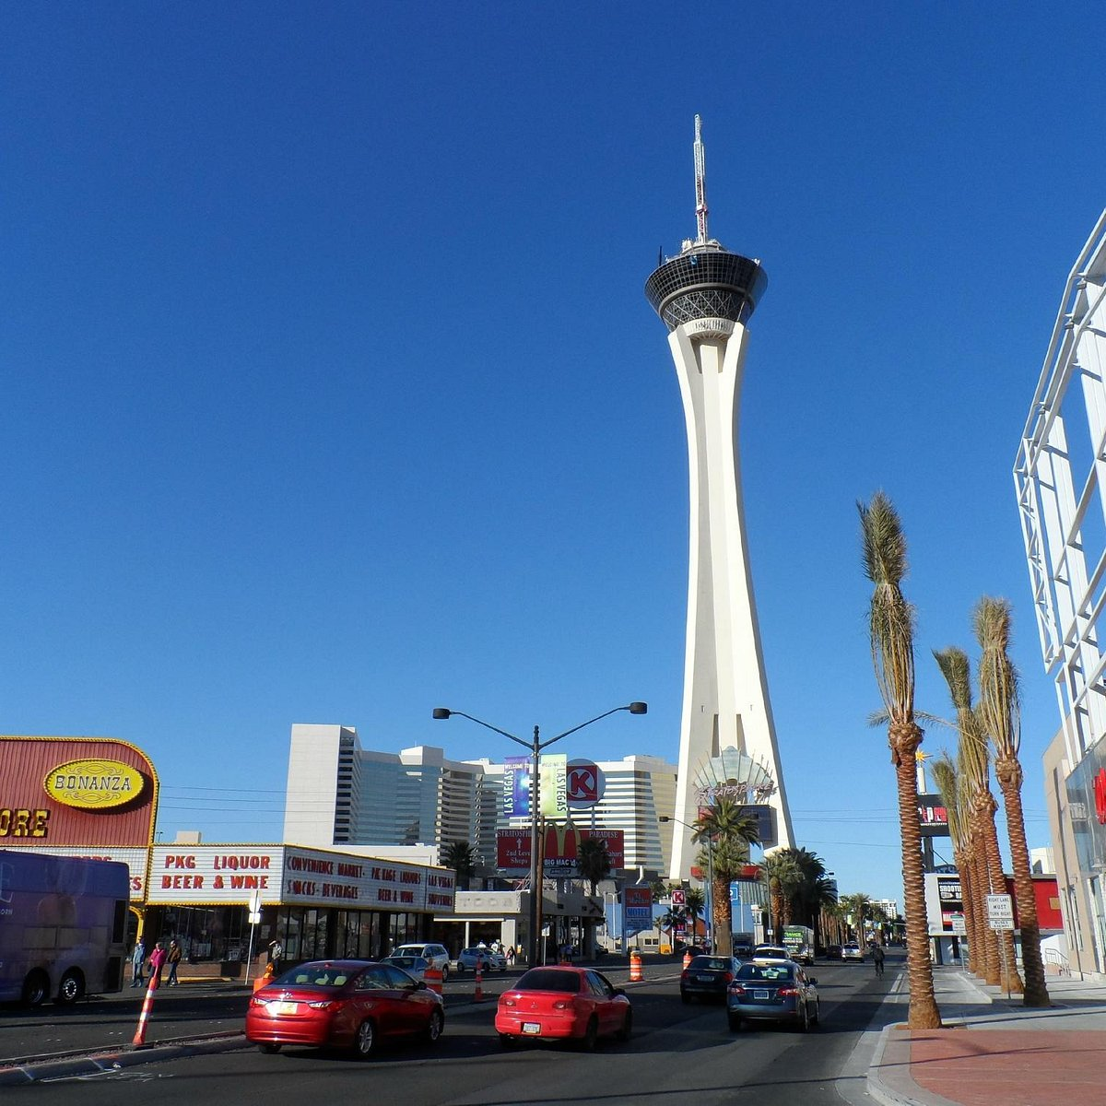

Slide 5
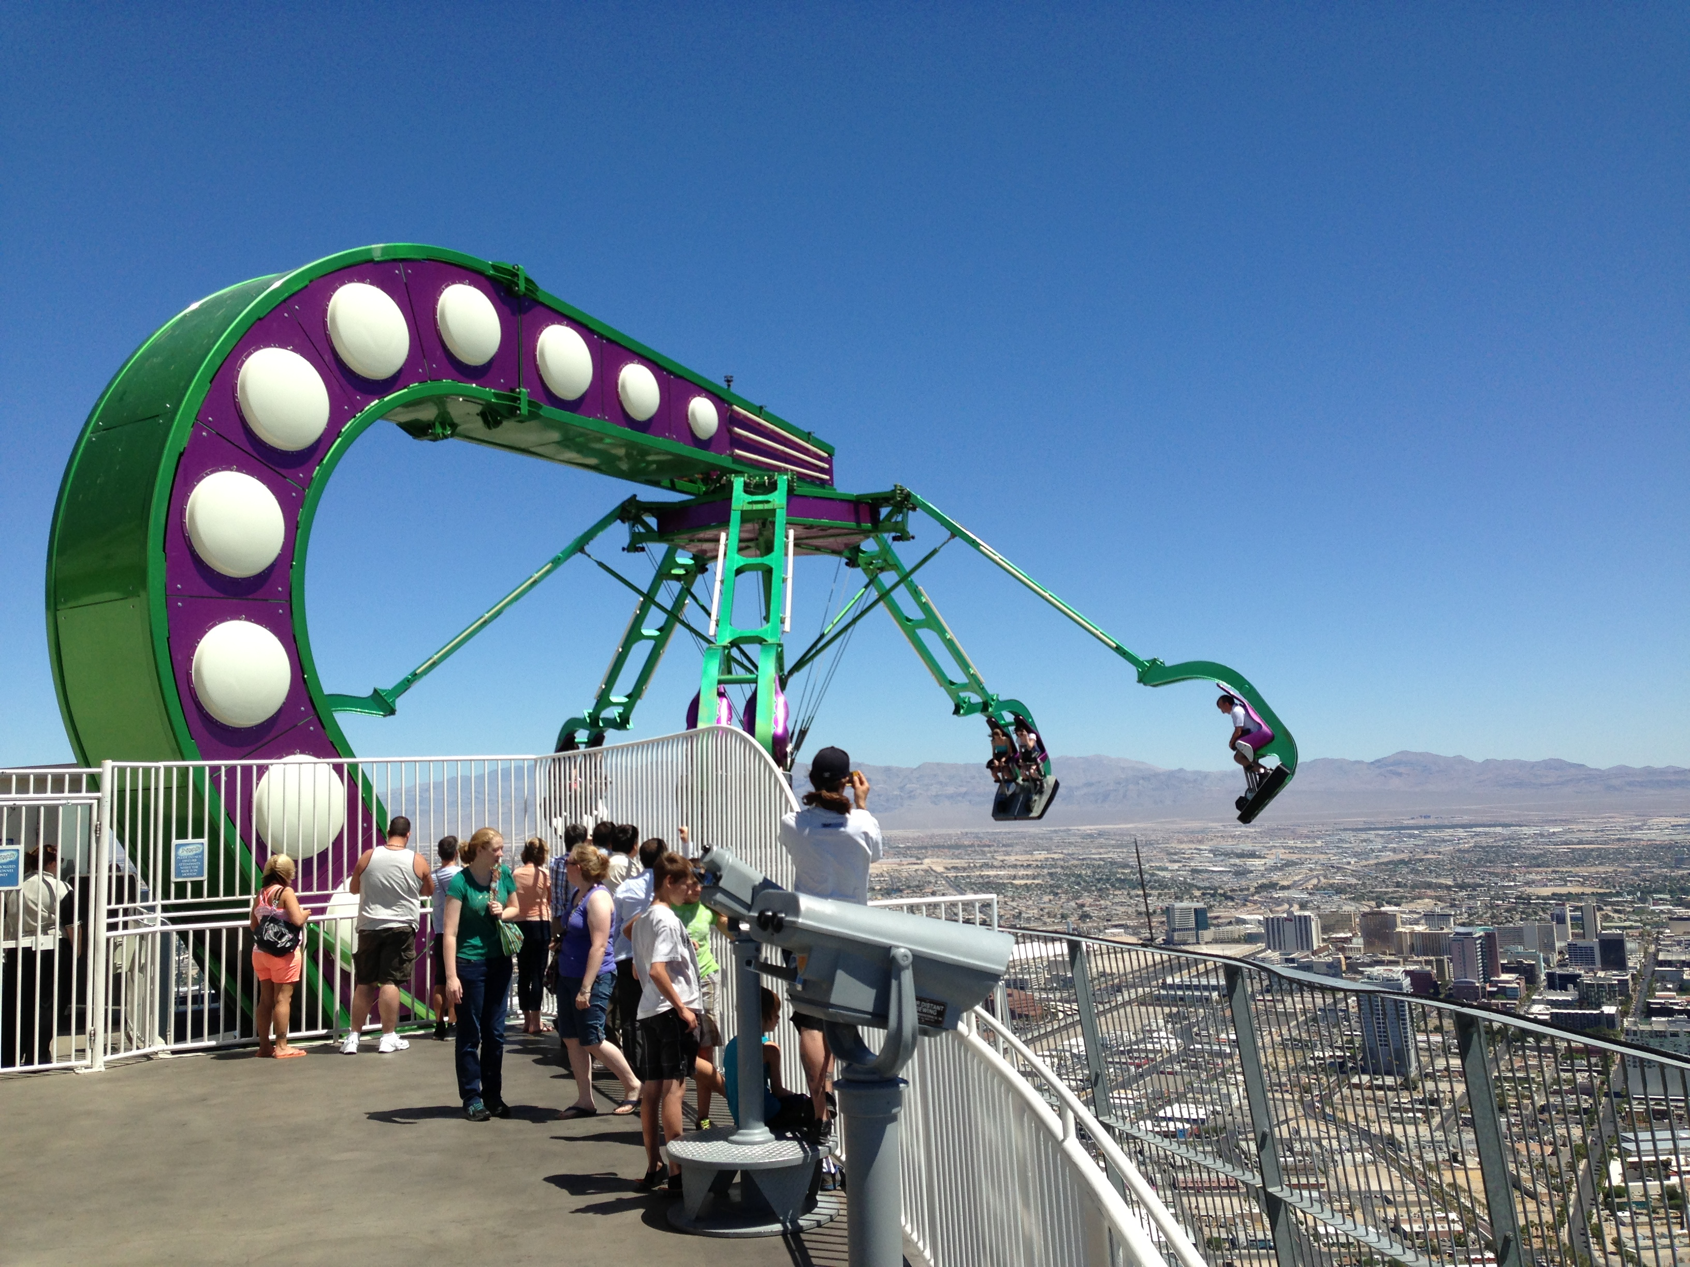

Slide 6
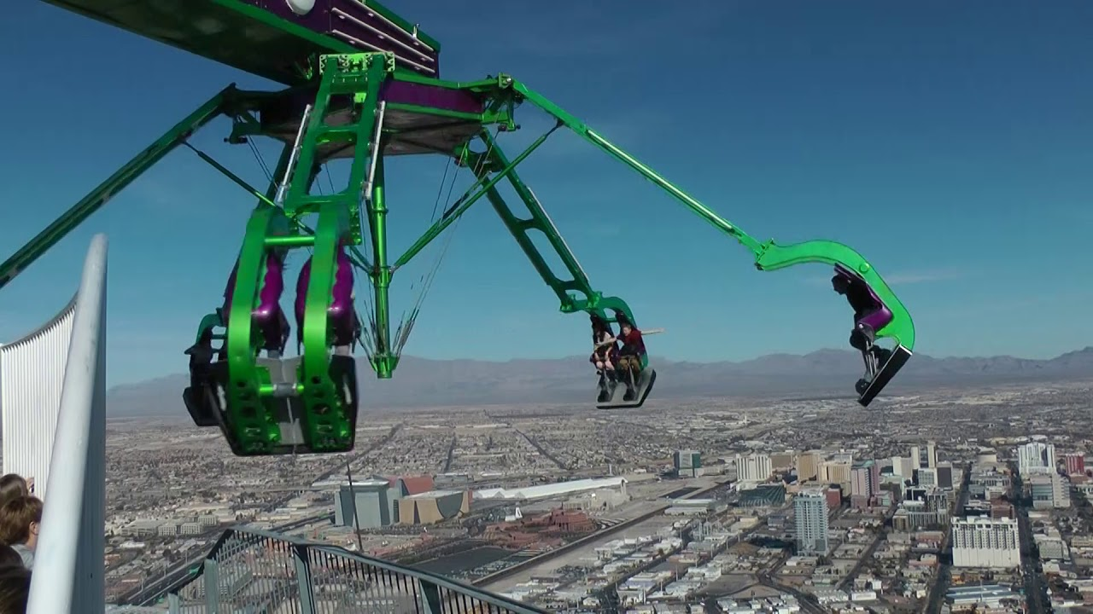

Slide 7
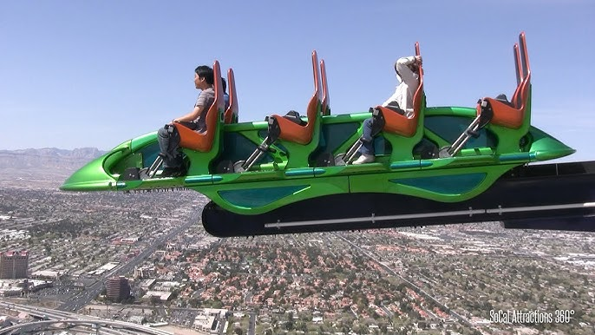

Slide 8
The resurrection of Christ and fear
(John 20:19-23)
The disciples fears
How were the disciples fear dispelled?
Christ’s presence
Christ’s love
Christ’s peace

