Slide 1
Bible Reading
Isaiah (ਯਸਾਯਾਹ) 49:15-16

Slide 2
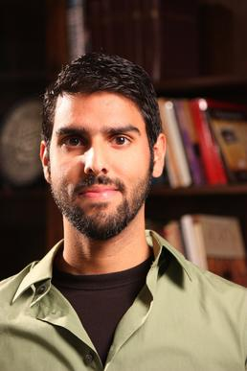
Nabeel Qureshi

Slide 3
(1) The Israelites felt abandoned and unloved by God

Slide 5
(1) The Israelites felt abandoned and unloved by God
(2) What was God’s reply?
God gives the example of mother with a nursing child
A mother and a nursing child is one of the strongest bonds in life
(ii) God gives a comparison of His love for His people
His love is greater and more intense than a mother’s love for a nursing child
(iii) God gives example of how He never forgets His people
Its like we are inscribed on the palm of His hand, we are constantly in His thoughts

